Slide 1

Quantum Reservoir Computing
Fourth Year Project:
By Rojar Raju
Supervisors:
Dr. Andreas Amann (Applied Mathematics)
Dr. Emanuel Popovici (Electrical Engineering)
Dr. Kaustubh Agarwal (Theoretical Physics)

Slide 2
Structure
Motivation
Background
Setup
Hamiltonians
1+1 system
Quantum Gates
Density matrices (after Rabii results)
Results
Rabii Oscillations
Fidelity/Purity Curves
Potential future research endeavors and improvements
Notes:
The way that this presentation is going to be structured is that I will be giving a motivation as to why qrc is an interesting area of research, then I will give so elementeray background to QM and then an in depth discussion of QRC and finally I will talk about my results and potential future endevores or improvements.

Slide 3
Motivation
Promise of Quantum Computing to be viable soon
Misconception all problems can be solved by Quantum Computers
Current quantum computers are noisy
Entanglement with the environment
Quantum Reservoir Computing (QRC) provides an alternative approach
Notes:
Most quantum computeres are to nosiy to be considered viable, we are in the so called noisy intermediate scale quantum era
fault tolerance is to high and we haven’t yet achieved quantum supremacy
in other words we don’t have quantum computers for general use that dominate over classical computers as of yet
Research group in china showed supremacy using photonic qcomp in very specific environments
QRC provides an alternative approach, where info processing is more efficient and less complex aswell as cost efficient
As of 2022 IBM, the leading frotiers in QC, their qcomp have 400 qubits, and these qubits are like regular classical bits, 0s and 1s but we are dealing with quantum computers and so quantum bits which invoke the benifiecal properties of qm.
Why? Quantum systems decohere due to the interaction/entanglement with the environment
QEC

Slide 4
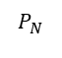
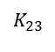
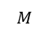
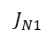
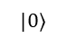
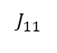
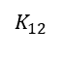
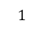
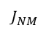
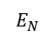
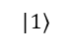
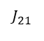
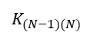
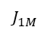
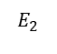
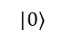
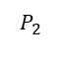
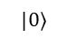
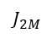
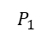
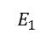
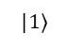
Background: A Many Body Quantum System
Pumping Energy
$$P_{1}$$
$$P_{2}$$
$$P_{N}$$
Hopping Terms
Onsite Potential
$$|1⟩$$
$$|1⟩$$
$$K_{(N−1)(N)}$$
$$|1⟩$$
N Reservoir Qubits (RQ)
$$|0⟩$$
$$|0⟩$$
$$|0⟩$$
$$J_{2M}$$
$$J_{1M}$$
$$J_{NM}$$
Coupling Strengths
$$J_{11}$$
$$J_{21}$$
$$J_{N1}$$
M Computational Qubits (CQ)

Slide 5
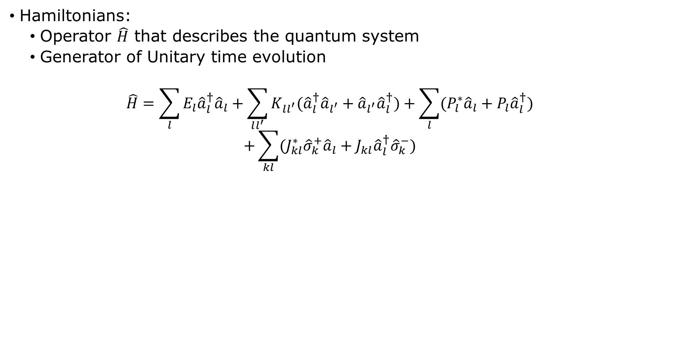
Hamiltonians:
Operator $\hat{H}$ that describes the quantum system
Generator of Unitary time evolution
$$\hat{H}=\sum_{l}{E_{l}{\hat{a}}_{l}^{†}{\hat{a}}_{l}+\sum_{ll^{′}}{K_{ll^{′}}({\hat{a}}_{l}^{†}{\hat{a}}_{l^{′}}}}+{\hat{a}}_{l^{′}}{\hat{a}}_{l}^{†})+\sum_{l}{(P_{l}^{∗}{\hat{a}}_{l}+P_{l}{\hat{a}}_{l}^{†})}$$
$$+\sum_{kl}{(J_{kl}^{∗}{\hat{σ}}_{k}^{+}{\hat{a}}_{l}+J_{kl}{\hat{a}}_{l}^{†}{\hat{σ}}_{k}^{−})}$$
$$Pauli matrices$$
$$σ_{k}^{±}=\frac{1}{2}(σ_{k}^{x}∓iσ_{k}^{y})$$
$${\hat{a}}^{†}−creation \& \hat{a}−annhilation operators$$
$$σ_{k}^{+}=\left[\begin{matrix}0 & 0 \\ 1 & 0\end{matrix}\right] \& { σ}_{k}^{−}=\left[\begin{matrix}0 & 1 \\ 0 & 0\end{matrix}\right]$$

Slide 6
Simple Analysis: 1+1 System
P
1 Reservoir Qubit (RQ)
$$|1⟩$$
E
$$|0⟩$$
J
1 Computational Qubit (CQ)

Slide 7
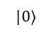
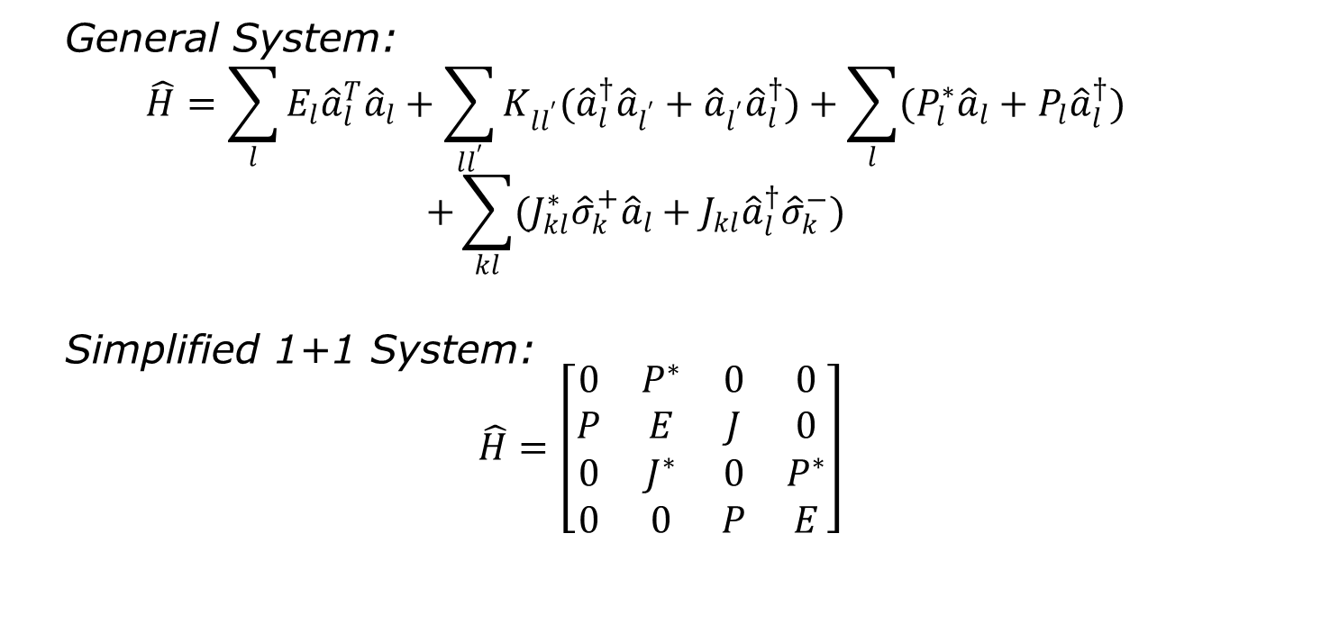
Hamiltonian for a 1+1 system
P
General System:
$$\hat{H}=\sum_{l}{E_{l}{\hat{a}}_{l}^{T}{\hat{a}}_{l}+\sum_{ll^{′}}{K_{ll^{′}}({\hat{a}}_{l}^{†}{\hat{a}}_{l^{′}}}}+{\hat{a}}_{l^{′}}{\hat{a}}_{l}^{†})+\sum_{l}{(P_{l}^{∗}{\hat{a}}_{l}+P_{l}{\hat{a}}_{l}^{†})}$$
$$+\sum_{kl}{(J_{kl}^{∗}{\hat{σ}}_{k}^{+}{\hat{a}}_{l}+J_{kl}{\hat{a}}_{l}^{†}{\hat{σ}}_{k}^{−})}$$
Simplified 1+1 System:
$$\hat{H}=\left[\begin{matrix}0 & P^{∗} & 0 & 0 \\ P & E & J & 0 \\ 0 & J^{∗} & 0 & P^{∗} \\ 0 & 0 & P & E\end{matrix}\right]$$
1 RQ
$$|1⟩$$
E
$$|0⟩$$
J
1 CQ

Slide 8
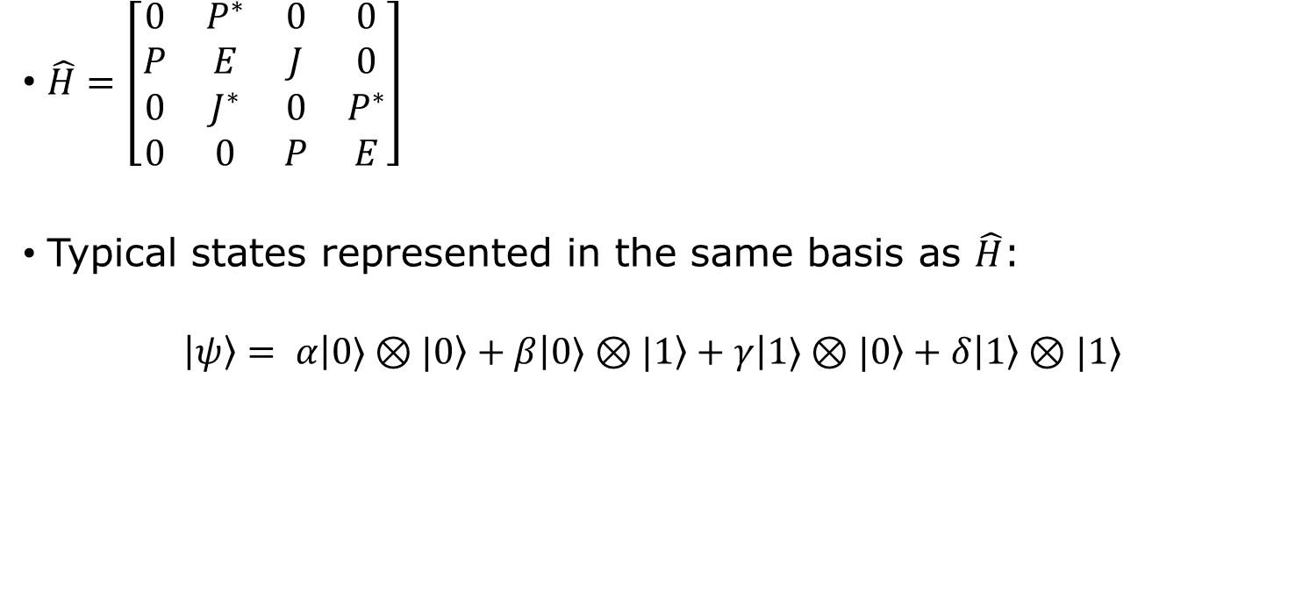
Simple Analysis: 1+1 System
P
$\hat{H}=\left[\begin{matrix}0 & P^{∗} & 0 & 0 \\ P & E & J & 0 \\ 0 & J^{∗} & 0 & P^{∗} \\ 0 & 0 & P & E\end{matrix}\right]$
Typical states represented in the same basis as $\hat{H}$:
$$\left|ψ\right\rangle = α\left|0⟩⊗|0\right\rangle +β\left|0⟩⊗|1\right\rangle +γ\left|1⟩⊗|0\right\rangle +δ\left|1\right\rangle ⊗|1⟩$$
1 RQ
$$|1⟩$$
E
$$|0⟩$$
J
1 CQ
Representation: $\left|CQ⟩⊗|RQ\right\rangle$ = $\left|CQ RQ\right\rangle$

Slide 9
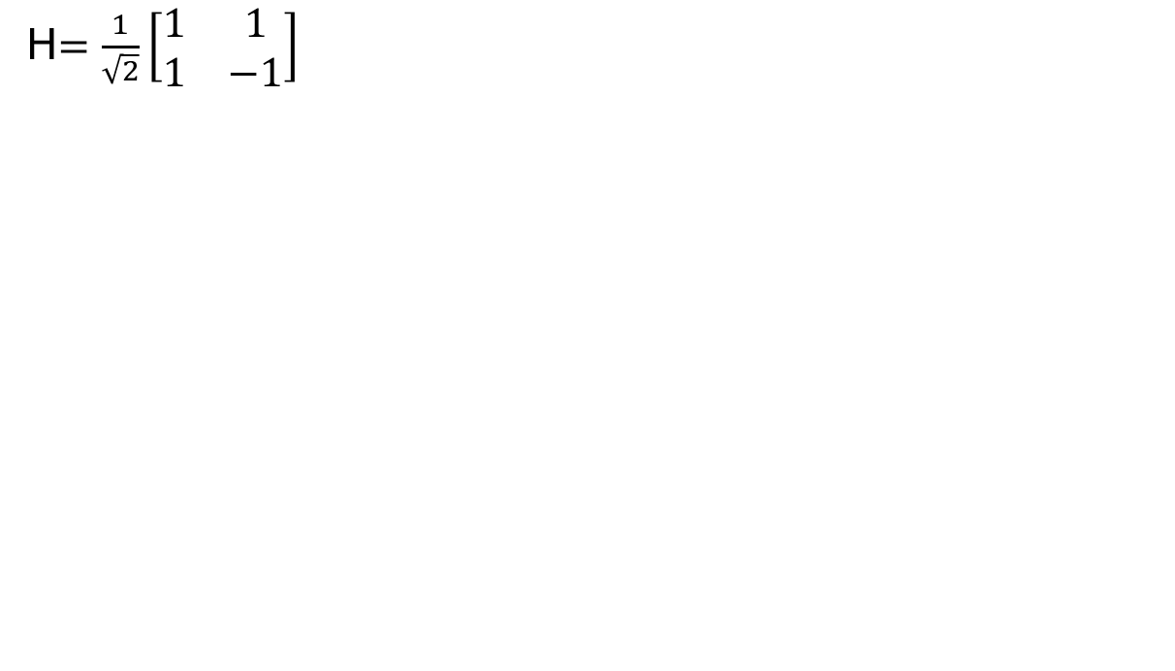
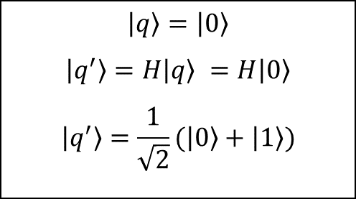
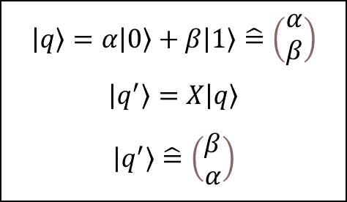
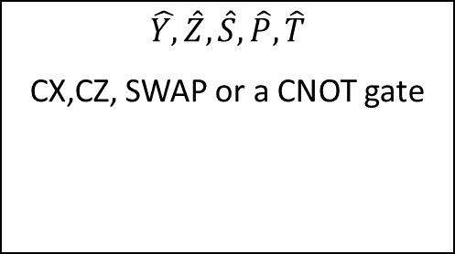
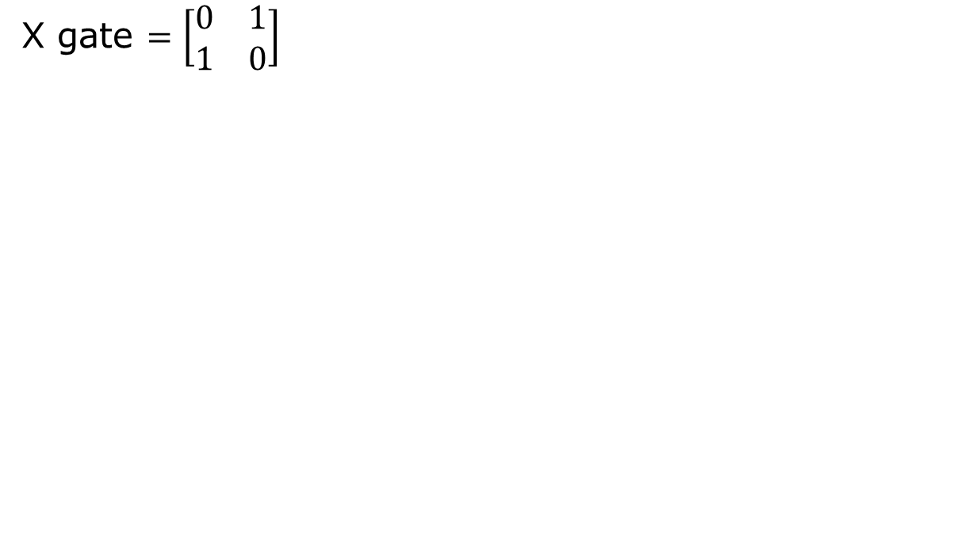
Quantum Gates
P
Reservoir replaced by a quantum circuit
Classical Logic gates = Quantum Gates simulation
Classical And/NOT gates → Quantum TOFFOLI/X gates
1 RQ
$$|1⟩$$
E
$$|0⟩$$
J
H$=\frac{1}{\sqrt{2}}\left[\begin{matrix}1 & 1 \\ 1 & −1\end{matrix}\right]$
X gate $=\left[\begin{matrix}0 & 1 \\ 1 & 0\end{matrix}\right]$
Other examples:
1 CQ
$$\left|q\right\rangle =α\left|0\right\rangle +β\left|1\right\rangle \hat{=}\left(\begin{matrix}α \\ β\end{matrix}\right)$$
$$\left|q^{′}\right\rangle =X\left|q\right\rangle$$
$$\left|q^{′}\right\rangle \hat{=}\left(\begin{matrix}β \\ α\end{matrix}\right)$$
$$\left|q\right\rangle =\left|0\right\rangle$$
$$\left|q^{′}\right\rangle =H\left|q\right\rangle =H\left|0\right\rangle$$
$$\left|q^{′}\right\rangle =\frac{1}{\sqrt{2}}(\left|0\right\rangle +\left|1\right\rangle )$$
$$\hat{Y,}\hat{Z},\hat{S},\hat{P},\hat{T}$$
CX,CZ, SWAP or a CNOT gate

Slide 10
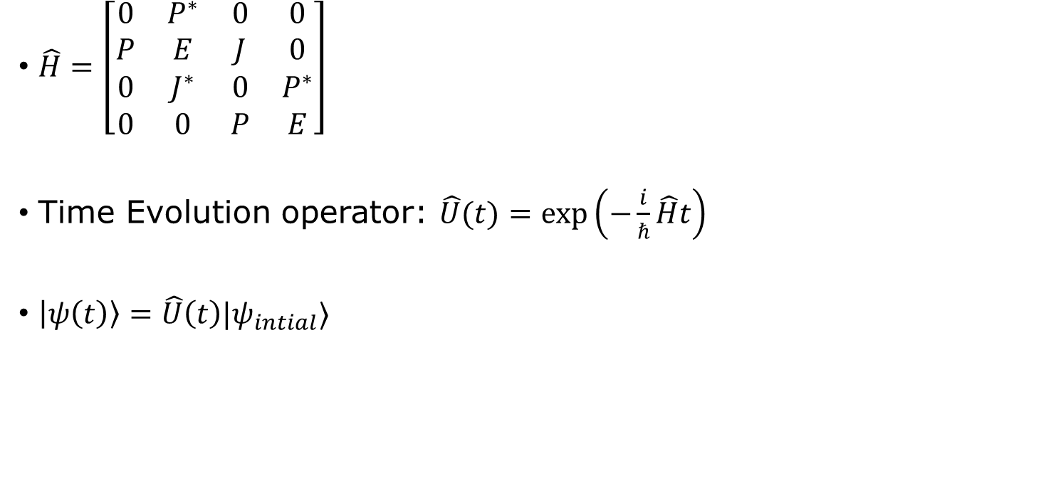
Evolution of a 1+1 system:
P
$\hat{H}=\left[\begin{matrix}0 & P^{∗} & 0 & 0 \\ P & E & J & 0 \\ 0 & J^{∗} & 0 & P^{∗} \\ 0 & 0 & P & E\end{matrix}\right]$
Time Evolution operator: $\hat{U}(t)=\exp\left(−\frac{i}{ℏ}\hat{H}t\right)$
$\left|ψ\left(t\right)\right\rangle =\hat{U}\left(t\right)|ψ_{intial}⟩$
1 RQ
$$|1⟩$$
E
$$|0⟩$$
J
1 CQ

Slide 11
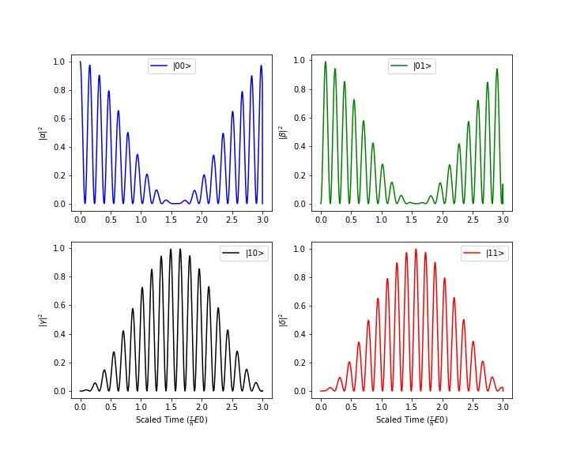
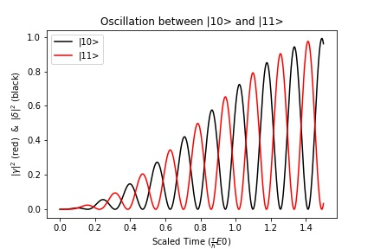
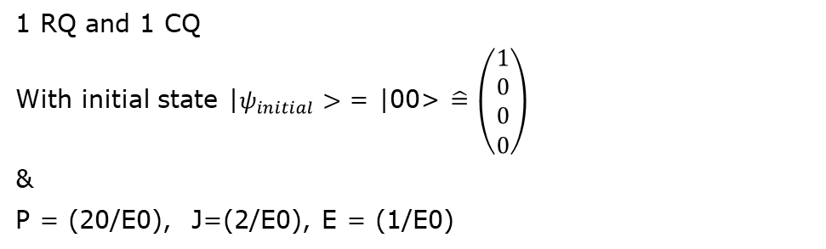
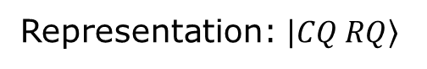
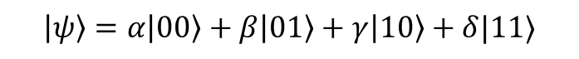
Results: Rabii oscillations
$$\left|ψ\right\rangle =α\left|00\right\rangle +β\left|01\right\rangle +γ\left|10\right\rangle +δ|11⟩$$
Representation: $\left|CQ RQ\right\rangle$
1 RQ and 1 CQ
With initial state |$ψ_{initial}>$ = |00> $\hat{=}$ $\left(\begin{matrix}1 \\ 0 \\ 0 \\ 0\end{matrix}\right)$
&
P = (20/E0), J=(2/E0), E = (1/E0)

Slide 12
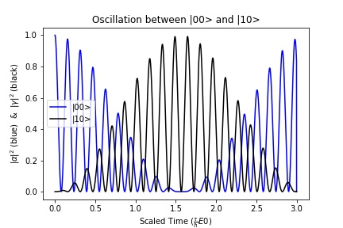
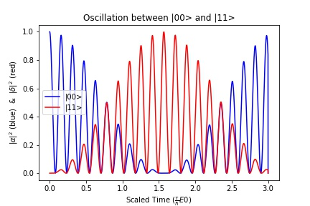
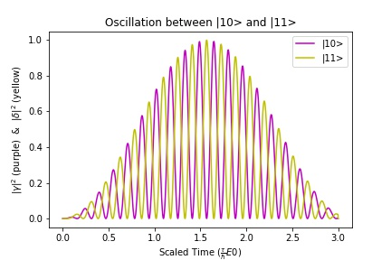
1 RQ and 1 CQ
With initial state |$ψ_{initial}>$ = |00> $\hat{=}$ $\left(\begin{matrix}1 \\ 0 \\ 0 \\ 0\end{matrix}\right)$
&
P = (20/E0), J=(2/E0), E = (1/E0)

Slide 13
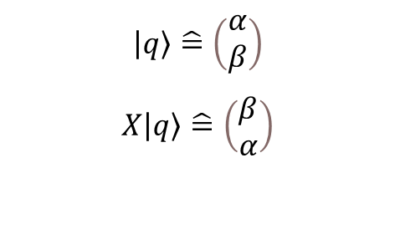
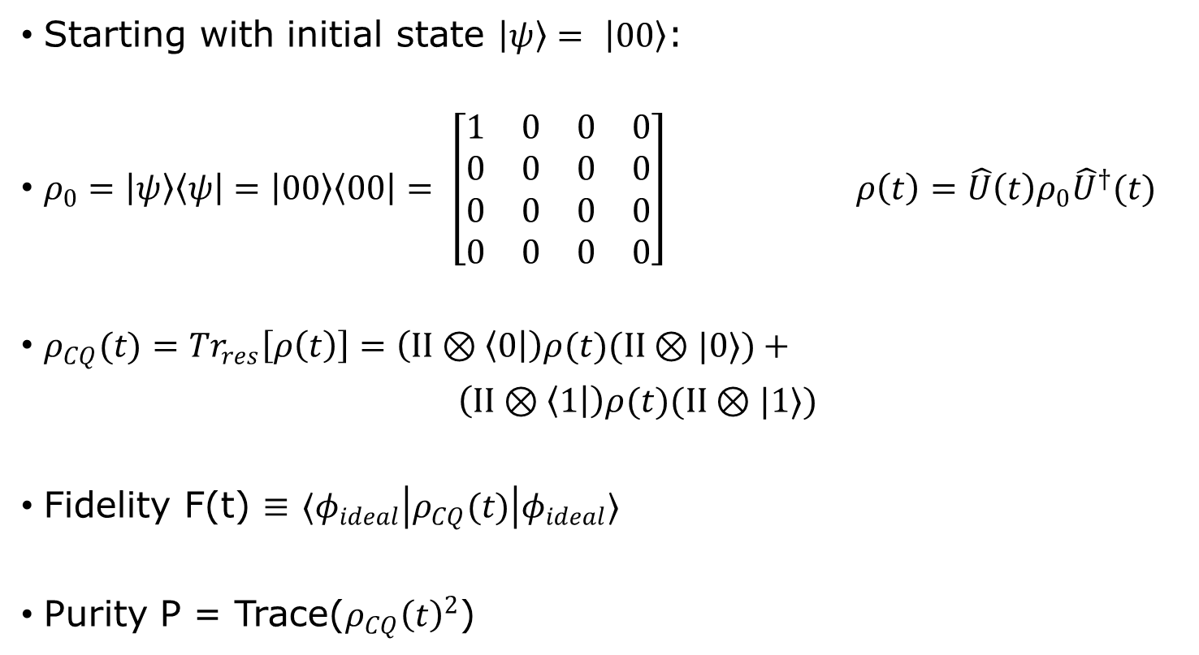
Further Analysis: Simulating an X gate
P
Starting with initial state $\left|ψ\right\rangle =$ $\left|00\right\rangle$:
$ρ_{0}=\left|ψ\right\rangle \left\langle ψ\right|=\left|00\right\rangle \left\langle 00\right|= \left[\begin{matrix}1 & 0 & 0 & 0 \\ 0 & 0 & 0 & 0 \\ 0 & 0 & 0 & 0 \\ 0 & 0 & 0 & 0\end{matrix}\right]$ $ρ\left(t\right)=\hat{U}\left(t\right)ρ_{0}{\hat{U}}^{†}(t)$
$ρ_{CQ}(t)={Tr}_{res}\left[ρ\left(t\right)\right]=\left(II⊗\left\langle 0\right|\right)ρ(t)(II⊗|0⟩)+$
$\left(II⊗\left\langle 1\right|\right)ρ(t)(II⊗|1⟩)$
Fidelity F(t) $≡$ $⟨φ_{ideal}\left|ρ_{CQ}(t)\right|φ_{ideal}⟩$
Purity P = Trace($ρ_{CQ}{\left(t\right)}^{2}$)
1 RQ
$$|1⟩$$
E
$$|0⟩$$
J
$$\left|q\right\rangle \hat{=}\left(\begin{matrix}α \\ β\end{matrix}\right)$$
$$X\left|q\right\rangle \hat{=}\left(\begin{matrix}β \\ α\end{matrix}\right)$$
1 CQ
F = 1 : ideal
F < 1 : non ideal
P = 1 : pure state
P < 1 : not pure state

Slide 14
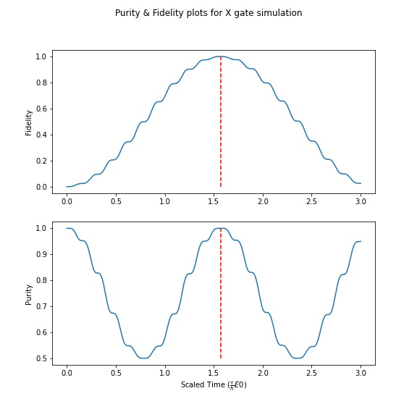
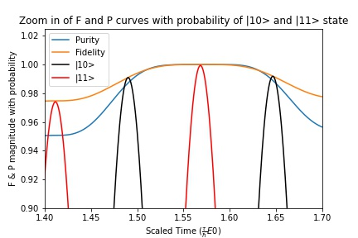
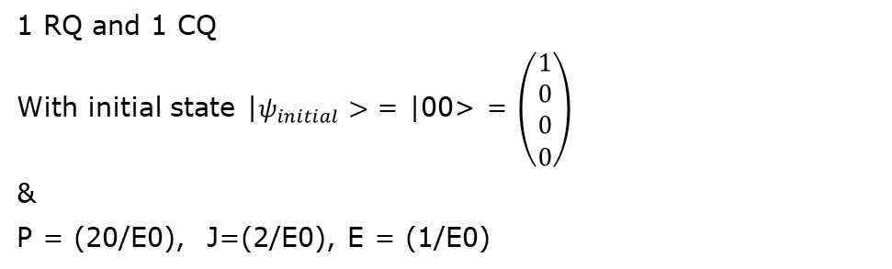
Purity & Fidelity plots for X gate simulation
Zoom in of F and P curves
1 RQ and 1 CQ
With initial state |$ψ_{initial}>$ = |00> = $\left(\begin{matrix}1 \\ 0 \\ 0 \\ 0\end{matrix}\right)$
&
P = (20/E0), J=(2/E0), E = (1/E0)

Slide 15
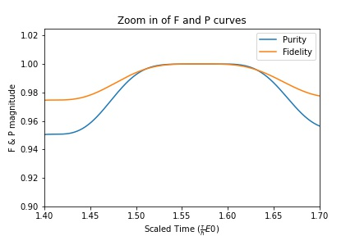
Purity & Fidelity plots for X gate simulation
Zoom in of F and P curves
1 RQ and 1 CQ
With initial state |$ψ_{initial}>$ = |00> = $\left(\begin{matrix}1 \\ 0 \\ 0 \\ 0\end{matrix}\right)$
&
P = (20/E0), J=(2/E0), E = (1/E0)

Slide 16
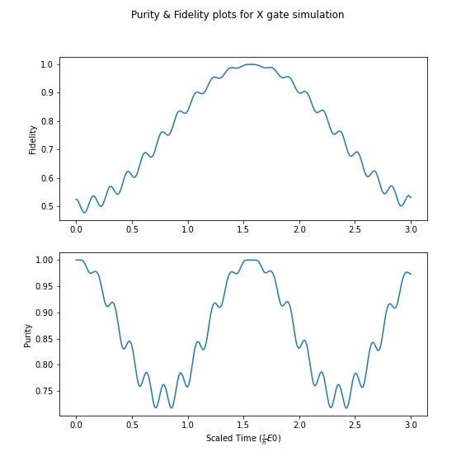
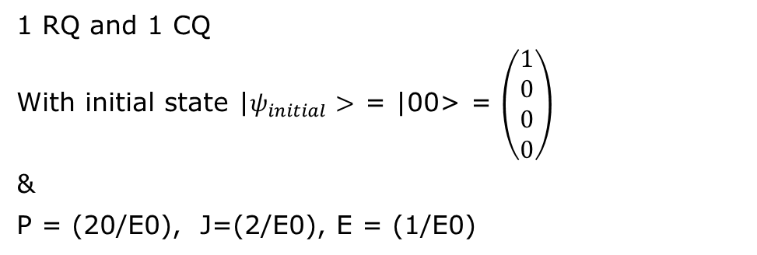
Purity & Fidelity plots for X gate simulation
1 RQ and 1 CQ
With initial state |$ψ_{initial}>$ = |00> = $\left(\begin{matrix}1 \\ 0 \\ 0 \\ 0\end{matrix}\right)$
&
P = (20/E0), J=(2/E0), E = (1/E0)

Slide 17
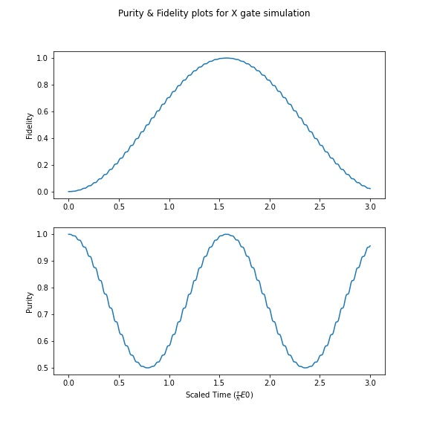
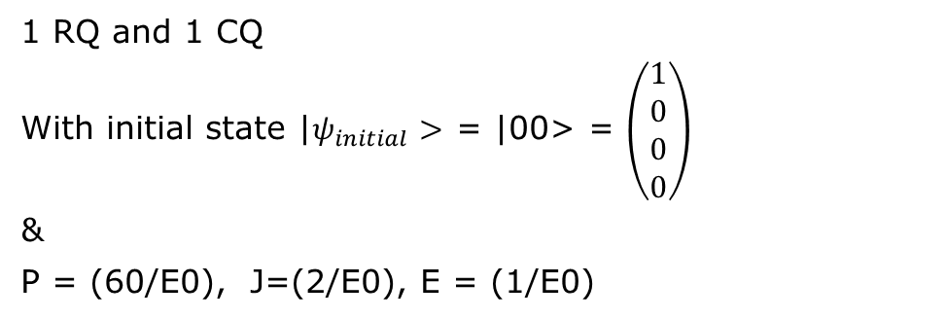
Purity & Fidelity plots for X gate simulation
1 RQ and 1 CQ
With initial state |$ψ_{initial}>$ = |00> = $\left(\begin{matrix}1 \\ 0 \\ 0 \\ 0\end{matrix}\right)$
&
P = (60/E0), J=(2/E0), E = (1/E0)

Slide 18
Improvements, improvements and more Improvements…
Check phase diagrams and see if there is such phase flip for different phase gates
If so we can characterize our system in terms of this periodicity
Need further research in order to comfirm this idea/theory
Improvements on code and theory needed
Questions?

Slide 19
Supplementary
(1)https://www.degruyter.com/document/doi/10.1515/nanoph-2016-0132/html
(2) https://link.springer.com/chapter/10.1007/978-3-540-39432-7_63
(3) Reasearch paper by Dr. Ghosh et al.
https://www.nature.com/articles/s42005-021-00606-3
(6)Quantum Supremacy? https://www.nature.com/articles/s41586-019-1666-5
(4) https://www.quantum-inspire.com/kbase/bloch-sphere/
More information on QEC:
https://arxiv.org/abs/1907.11157
Article1:IBM https://www.newscientist.com/article/2346074-ibm-unveils-worlds-largest-quantum-computer-at-433-qubits/#:~:text=Dial%20says%20that%20IBM's%20team,lowering%20noise%20and%20mitigating%20errors
(5) IBM Sim: https://www.quantum-inspire.com/kbase/bloch-sphere/
(7)Partial tracing/mixed states/density: https://www.ryanlarose.com/uploads/1/1/5/8/115879647/quic06-states-trace.pdf
Some useful videos:
https://www.youtube.com/watch?app=desktop&v=DhLbVPn5838
https://www.youtube.com/watch?v=LR5kfhrs4Cc

Slide 20





Background
$$\left|e\right\rangle$$
$$|g⟩$$
$\left|ψ\right\rangle =α\left|0\right\rangle +β\left|1\right\rangle =\left(\begin{matrix}α \\ β\end{matrix}\right)$
$⟨ψ|=⟨0|α^{∗}+⟨1|β^{∗}=(α^{∗} β^{∗})$
$\left|φ^{±}\right\rangle =\frac{1}{\sqrt{2}}({\left|0\right\rangle }_{A}⊗{\left|0\right\rangle }_{B}±{\left|1\right\rangle }_{A}⊗{\left|1\right\rangle }_{B})$
Hamiltonians:
Operator $\hat{H}$ that describes the quantum system
Generator of Unitary time evolution
$$\hat{H}=\sum_{l}{E_{l}{\hat{a}}_{l}^{T}{\hat{a}}_{l}+\sum_{ll^{′}}{K_{ll^{′}}({\hat{a}}_{l}^{T}{\hat{a}}_{l^{′}}}}+{\hat{a}}_{l^{′}}{\hat{a}}_{l}^{T})+\sum_{l}{(P_{l}^{∗}{\hat{a}}_{l}+P_{l}{\hat{a}}_{l}^{T})}$$
$$+\sum_{kl}{(\hat{J_{kl}^{∗}} {\hat{σ}}_{k}^{+}{\hat{a}}_{l}+J_{kl}{\hat{a}}_{l}^{T}{\hat{σ}}_{k}^{−})}$$
$$\left|e\right\rangle$$
$$|g⟩$$
$$\left|e\right\rangle$$
$$|g⟩$$
$$\left|e\right\rangle =\left({0 \atop 1}\right)=0\left|0\right\rangle +1\left|1\right\rangle : |1⟩$$
$$\left|g\right\rangle = \left({1 \atop 0}\right)=1\left|0\right\rangle +0\left|1\right\rangle :|0⟩$$
A picture of a representation of a 2 level system

Slide 21

Reservoir Computing
Key idea of RC => use fixed, randomly generated nodes/bits in reservoir
=> less computational cost, time and complexity
Maps input signals to higher dimensional computational basis through reservoir
Exhibits temporal dynamic behavior
Figure adapted from Daniel Brunner et al. (1)
Notes:
QRC -> RC
Basically uses the RNN architecture
What I mean by this is it has 3 layers containing nodes/bits
Input data res layer o/p
In RC, the nodes/bits reservoir layer is distruibuted randomly
Quantum domain

Slide 22




Quantum Reservoir Computing (QRC)
Figure adapted from Yudai Suzuki et al. (2)
Reservoir Qubits
Figure adapted from Daniel Brunner et al. (1)
Figure excerpt from paper by Dr. Ghosh (3) (research paper)
Computational Qubits
Notes:
Same similar structure

Slide 23







QRC 1+1 system
Input Layer
$\left|00\right\rangle ,|01⟩$, $|10⟩$, $|11⟩$
$One Reservoir Qubit$
(rq)
$$\left|e\right\rangle$$
$$|g⟩$$
$$\left|cq rq\right\rangle$$
Figure adapted from Yudai Suzuki et al. (3)
Train
$$One Computational Qubit$$
(cq)
$$\left|e\right\rangle$$
$$|g⟩$$

Slide 24





The Idea: Simulating an $\hat{X}$ gate
Reservoir replaced by a quantum circuit
Logic gates = Quantum Gates simulation
And/NOT gates → TOFFOLI/X gates
$$\left|q\right\rangle =\left|0\right\rangle$$
$$\left|q^{′}\right\rangle =\hat{X}\left|q\right\rangle =\hat{X}\left|0\right\rangle$$
$$\left|q^{′}\right\rangle =|1⟩$$
$$\left|q\right\rangle =\left|0\right\rangle$$
$$\left|q^{′}\right\rangle =\hat{H}\left|q\right\rangle =\hat{H}\left|0\right\rangle$$
$$\left|q^{′}\right\rangle =\frac{1}{\sqrt{2}}(\left|0\right\rangle +\left|1\right\rangle )$$
$$\left|q\right\rangle =α\left|0\right\rangle +β\left|1\right\rangle =\left(\begin{matrix}α \\ β\end{matrix}\right)$$
$$\left|q^{′}\right\rangle =\hat{X}\left|q\right\rangle$$
$$\left|q^{′}\right\rangle =\left(\begin{matrix}β \\ α\end{matrix}\right)$$
$$\hat{Y,}\hat{Z},\hat{S},\hat{P},\hat{T}$$
CX,CZ, SWAP or a CNOT gate

Slide 25


How is it done?
T = 0 qubits initialized, sample initial states where QN starts in vacuum state
Final state of combined system thus is given by
$$\left|ψ_{out}\right\rangle =\hat{U} \left|φ_{intial}\right\rangle ⊗{\left|vac\right\rangle }_{QN}$$
Analyze the evolution
$$T=0 :\left|00\right\rangle$$
$$T=t: a^{2}\left|00\right\rangle +b^{2}\left|01\right\rangle +c^{2}\left|10\right\rangle +d^{2}\left|11\right\rangle$$
i.e a superposition of states

Slide 26




Results: Rabii oscillations
$$a^{2}\left|00\right\rangle +b^{2}\left|01\right\rangle +c^{2}\left|10\right\rangle +d^{2}|11⟩$$
Representation: $\left|cq rq\right\rangle$
Figure (a)
Figure (a)
Figure (b)
1 RQ and 1 CQ
With initial state |00> = (1,0,0,0) &
P = (60/E0), J=(2/E0), E = (-0.5/E0)

Slide 27




Results: Rabii oscillations
$$a^{2}\left|00\right\rangle +b^{2}\left|01\right\rangle +c^{2}\left|10\right\rangle +d^{2}|11⟩$$
Representation: $\left|cq rq\right\rangle$
Figure (a)
Figure (b)
Figure (b)
1 RQ and 1 CQ
With initial state |00> = (1,0,0,0) &
P = (20/E0), J=(2/E0), E = (-0.5/E0)

Slide 28
Quantum Reservoir Computing (QRC)
Quantum Reservoir Computing →Reservoir Computing (RC) → Recurrent Neural Networks (RNN)
Connections between nodes
Output of nodes affect subsequent input to same nodes => training data to learn
Exhibits temporal dynamic behavior
Figure adapted from Daniel Brunner et al. (1)

Slide 29
Framework for computation based on RNN to create complex dynamical systems
Maps input signals to higher dimensional computational basis through reservoir
Key idea of RC => use fixed, randomly generated nodes/bits in reservoir
=> less computational cost, time and complexity
Reservoir = “black box”
Readout mechanism, obtains state of reservoir and maps it to output node
“Bucket of water” => Reservoir, perturbation on surface (2)
Figure adapted from Daniel Brunner et al. (1)

Slide 30


How is it done?
T = 0 qubits initialized, sample initial states where QN starts in vacuum state
Whole system evolves in time up to t =$τ$, corresponding to unitary operator
Final state of combined system thus is given by
Final state of qubits given by partial trace that traces out QN
Compute fidelity of each input state which is the overlap of the ideal final quantum state and the obtained state $ρ_{q}$
=>

Slide 31
Where we at with QRC?
Figure adapted from Yudai Suzuki et al. (3)
Fast learning, resulting in low training cost
Mapping inputs into a high-dimensional space
Limitations on number of qubits, IBM 433 qubits 2022, by 2023 1000+ qubits? (article:1)
More qubits => higher chance to for states to decohere due to interaction with environment
Basically, lose its quantum property => noisy data!
Quantum Error Correction, minimize decoherence maximize coherence? Active area of research for all things quantum!
Some more information: https://arxiv.org/abs/1907.11157

Slide 32

Quantum housekeeping
Figure adapted from Yudai Suzuki et al. (3)
Reservoir and input/output layer is in the quantum domain
Bits, quantum bits → qubits
Qubit can represent infinite # of states
Refrain from making a measurement, subject qubit to a series of quantum interactions
Interactions = rotate state vector, qubit evolving according to the quantum network subjected too
design a network where the final measurement will correspond to some information that you are looking for
Figure adapted from Quantum Inspire (4)

Slide 33

Extra information
2^n numbers to describe 'n’ qubits due to superposition of all possible states until measurement
Example: 2 qubit system => 4 states
00, 01, 10, 11 with some coefficients
4 numbers which characterise the quantum system
3 qubit system: 8 possible, 000, 001…111
Coefficients contain some information about quantum system
only on describing all the 2^n coefficients can we completely describe the system.

Slide 34

State and Density Matrix representation
In QM, two ways to represent a quantum system:
Wavefunction and Density Matrix representation
Wavefunction Representation:
A vector in Hilbert space which represents all possible states of a system
Can get probability of any measurement and time evolution of system based on some Hamiltonian
State of system completely determined by the wavefunction
Restricted to describing pure states with quantum probabilities
Density Matrix Representation
Mixed state representation, when system not in a pure state
Represents a statistical ensemble of pure states each with certain probability of occurring.
Describes the probability distribution of pure states that make up mixed state
Diagonal elements of matrix represent classical probabilities of finding system in certain state
Off diagonal elements represent coherence between states
Mixed state => partial information of system, do not know if you sample state u1 or u2 i.e
It is probabilistic
https://www.youtube.com/watch?app=desktop&v=DhLbVPn5838
https://www.youtube.com/watch?v=LR5kfhrs4Cc

Slide 35


$phi_{t}$

Slide 36

Back to QRC
Figure adapted from Yudai Suzuki et al. (3)
Reservoir → qubits, for example
Reservoir replaced by a quantum circuit
Logic gates = Quantum Gates
And/Or gates → CNOT, CX and TOFFOLI
gates
Hadamard gate
Advantages of QRC is that it can perform both classical and quantum tasks faster due to efficiency of processing input data
Need to control and stabilize the quantum reservoir, as well as the susceptibility of quantum systems to decohere and produce noise
IBM software, simulation (5)

Slide 37

Dr. Ghosh et al. and their published paper: Realising and compressing quantum circuits with QRC
Quantum Network (QN) => Reservoir
Input Exitation terms ‘P’, non interacting reservoir qubits, only interaction is with the output computational qubits
Quantum Tunneling is the only interaction, governed by ‘J’ coefficient
QN acts like a quantum operation by tuning P and/or J values
Based on symmetry of system, certain P and J combination can be interpreted as an X gate, or Z phase gate
Figure excerpt from paper (6) (research paper)

Slide 38


Simulation of Single qubit gates of over 2000 randomly generated states.
P/E0 = (60,60,0.1,4.96,0.1,0.1) &
t*E0/hbar = (3.08, 16.68, 6.28, 1.53, 3.07, 4.71)

Slide 39



Keeping P,J,E constant and sampling 2000 initial states

Slide 40


Keeping initial state constant (z1,z2) through iteration, phi_initial = z1|0>+z2|1>, our computational qubit sample
Figure (a)
Figure (b)

